Slide 1
Graph Data Structures

Slide 2
Outline
In this topic, we will cover the representation of graphs on a computer
We will examine:
an adjacency matrix representation
smaller representations and pointer arithmetic
sparse matrices and linked lists

Slide 3
Background
Project 5 requires you to store a graph with a given number of vertices numbered 0 through n – 1
Initially, there are no edges between these n vertices
The insert command adds edges to the graph while the number vertices remains unchanged

Slide 4
Background
In this laboratory, we will look at techniques for storing the edges of a graph
This laboratory will focus on weighted graphs, however, for unweighted graphs, one can easily use bool in place of double

Slide 5
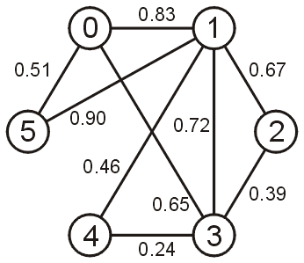
Background
To demonstrate these techniques, we will look at storing the edges of the following graph:

Slide 6
Adjacency Matrix
A graph of n vertices may have up to
edges
The first straight-forward implementation is an adjacency matrix

Slide 7
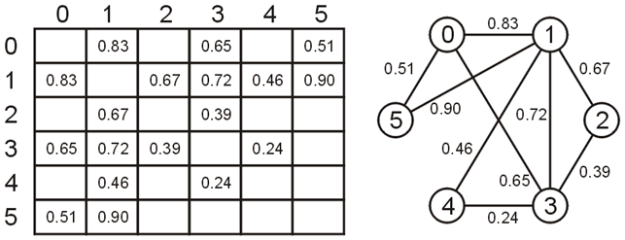
Adjacency Matrix
Define an n × n matrix A = (a_{ij}) and if the vertices v_{i} and v_{j} are connected with weight w, then set a_{ij} = w and a_{ji} = w
That is, the matrix is symmetric, e.g.,

Slide 8
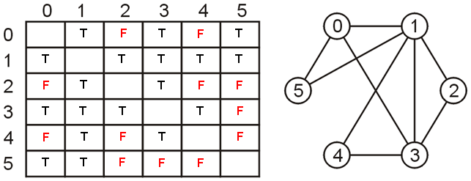
Adjacency Matrix
An unweighted graph may be saved as an array of Boolean values
vertices v_{i} and v_{j} are connected then set a_{ij} = a_{ji} = true

Slide 9
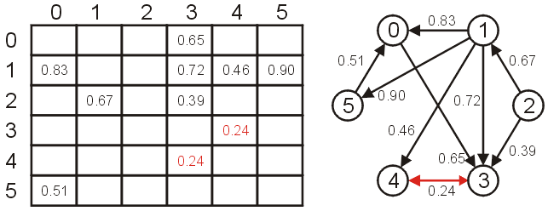
Adjacency Matrix
If the graph was directed, then the matrix would not necessarily be symmetric

Slide 10
Adjacency Matrix
First we must allocate memory for a two-dimensional array
C++ does not have native support for anything more than one-dimensional arrays, thus how do we store a two-dimensional array?
as an array of arrays

Slide 11
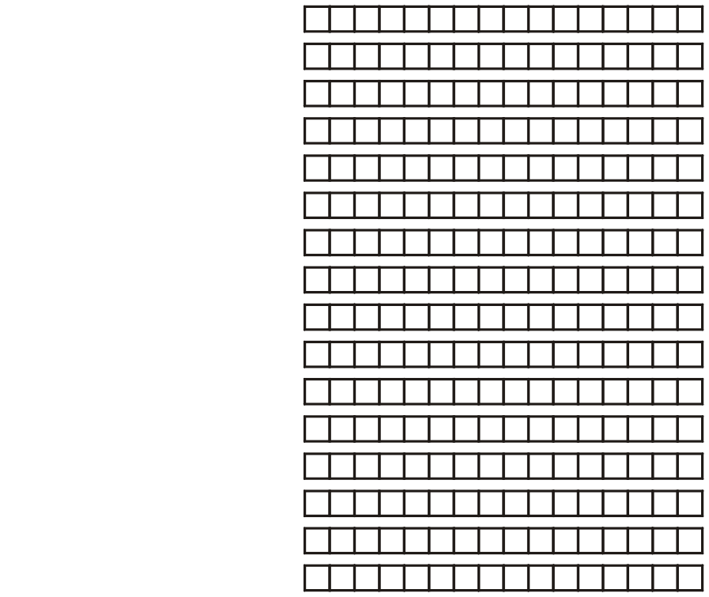
Adjacency Matrix
Suppose we require a 16 × 16 matrix of double-precision floating-point numbers
Each row of the matrix can be represented by an array
The address of the first entry must be stored in a pointer to a double:
double *

Slide 12
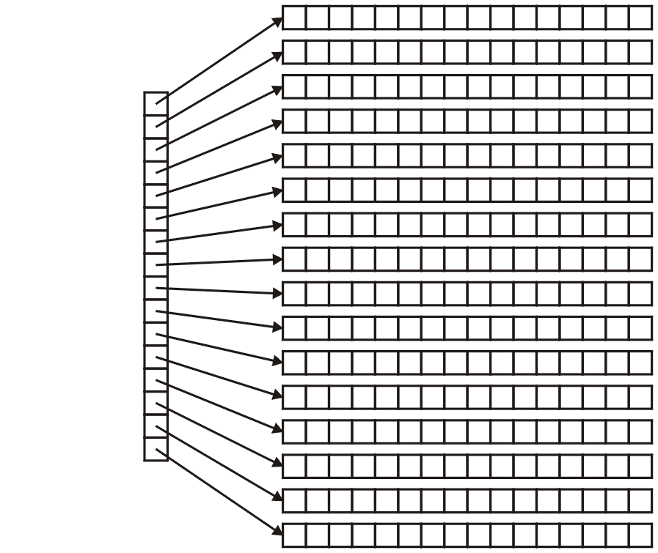
Adjacency Matrix
However, because we must store 16 of these pointers-to-doubles, it makes sense that we store these in an array
What is the declaration of this array?
Well, we must store a pointer to a pointer to a double
That is: double **

Slide 13
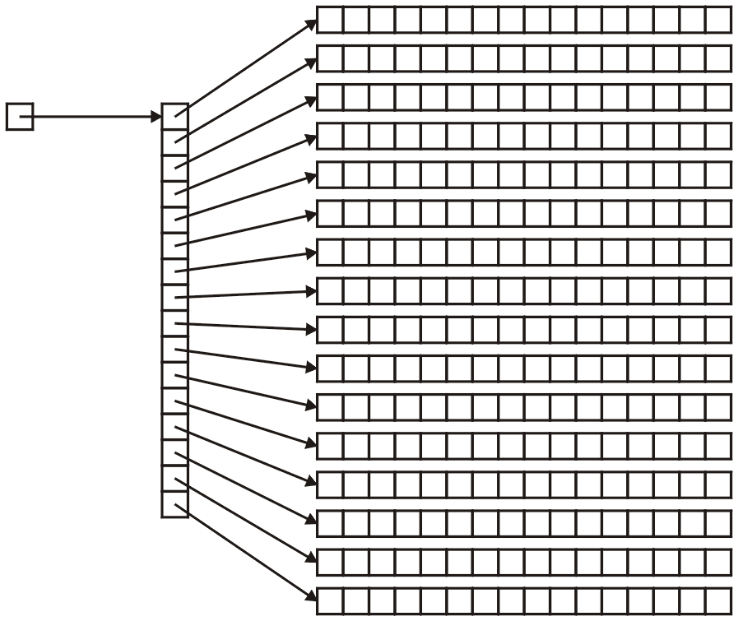
Adjacency Matrix
Thus, the address of the first array must be declared to be:
double **matrix;

Slide 14
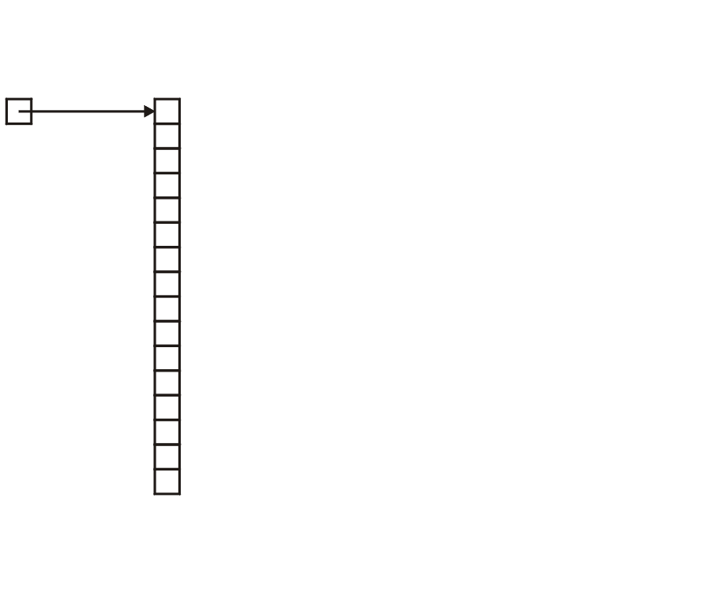
Adjacency Matrix
The next question is memory allocation
First, we must allocate the memory for the array of pointers to doubles:
matrix = new double * [16];

Slide 15
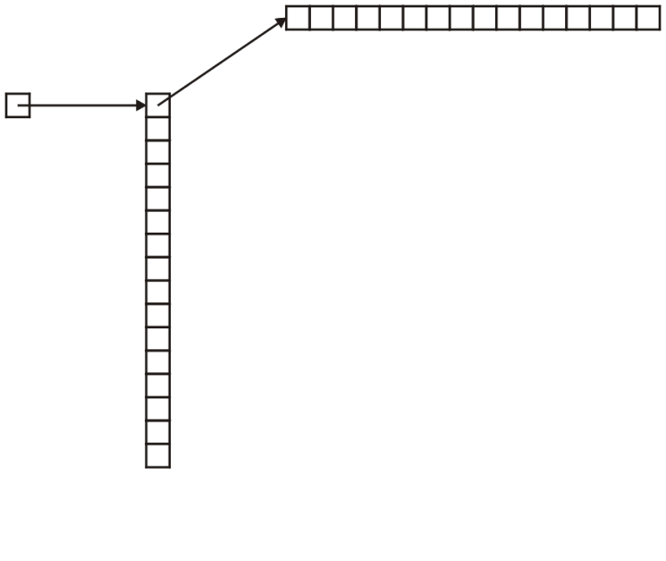
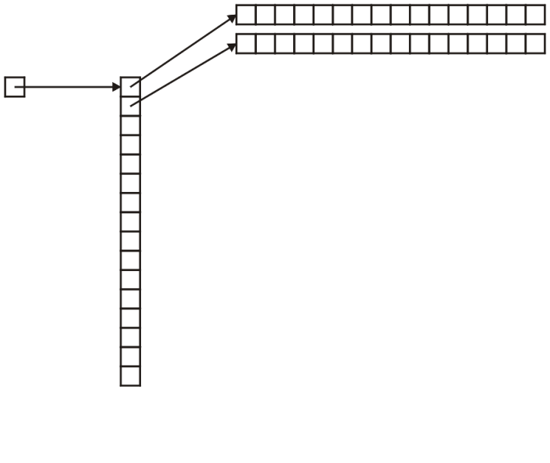
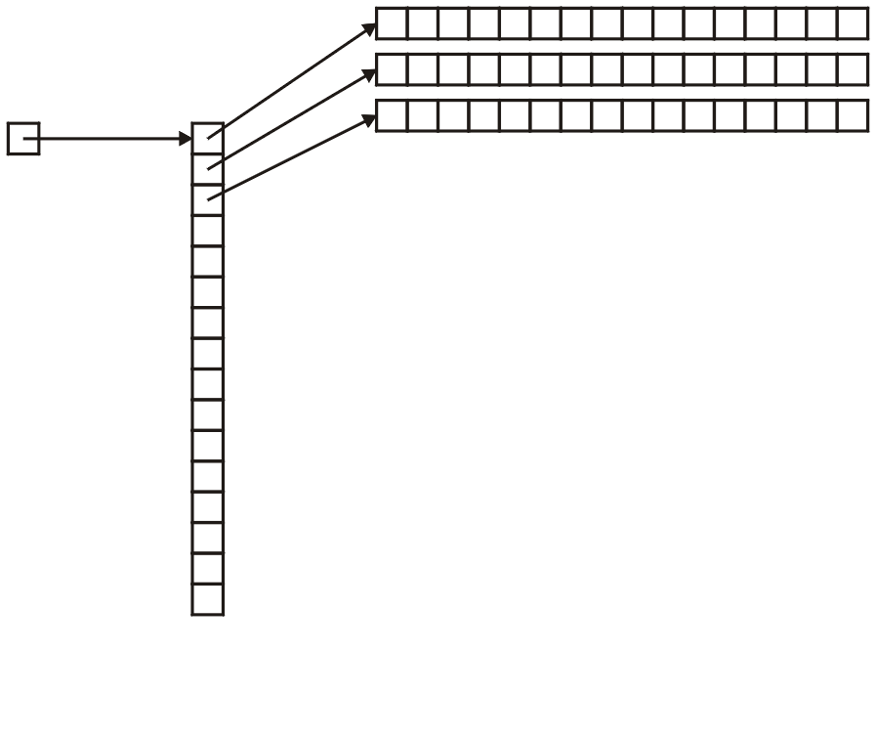
Adjacency Matrix
Next, to each entry of this matrix, we must assign the memory allocated for an array of doubles
for ( int i = 0; i < 16; ++i ) {
matrix[i] = new double[16];
}

Slide 16
Adjacency Matrix
Accessing a matrix is done through a double index, e.g., matrix[3][4]
You can interpret this as (matrix[3])[4]

Slide 17
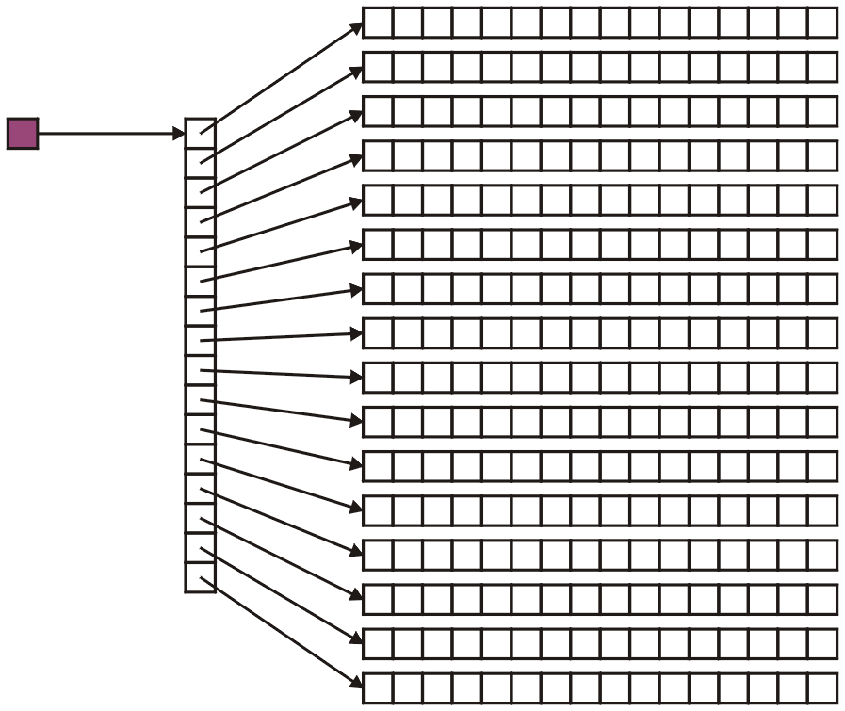
Adjacency Matrix
Recall that in matrix[3][4], the variable matrix is a pointer-to-a-pointer-to-a-double:

Slide 18
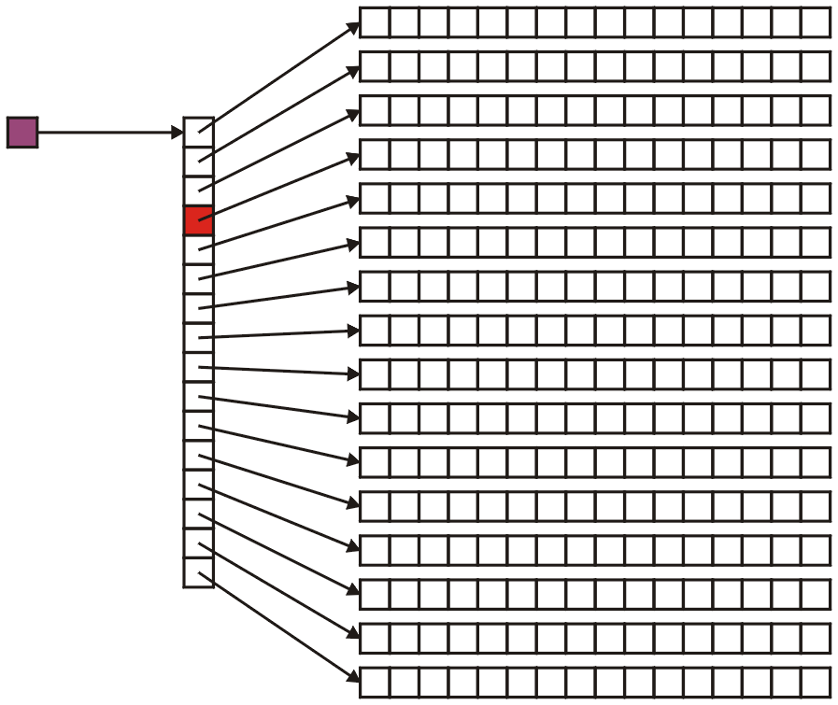
Adjacency Matrix
Therefore, matrix[3] is a pointer-to-a-double:

Slide 19
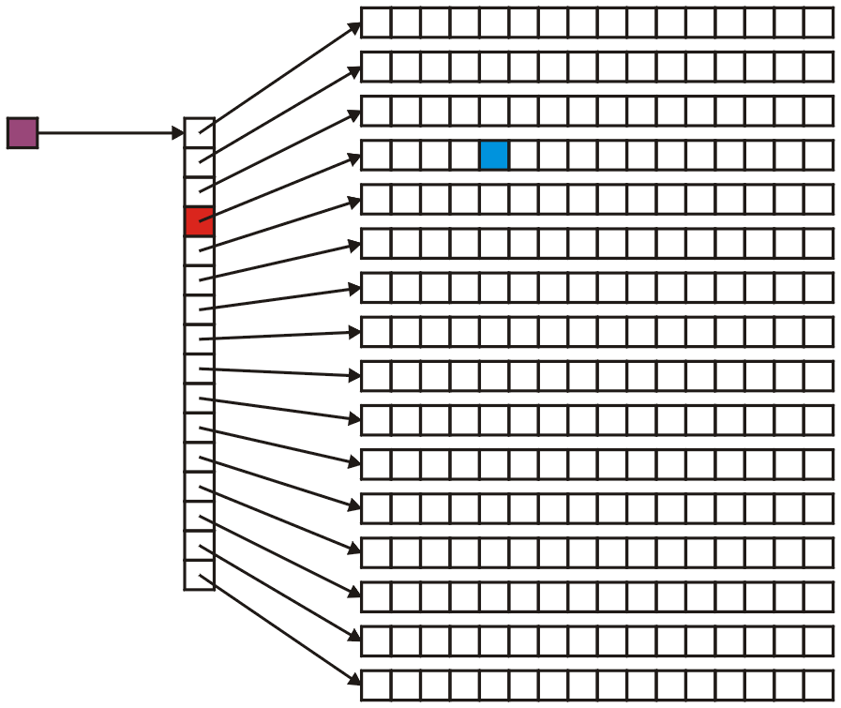
Adjacency Matrix
And consequently, matrix[3][4] is a double:

Slide 20
C++ Notation Warning
Do not use matrix[3, 4] because:
in C++, the comma operator evaluates the operands in order from left-to-right
the value is the last one
Therefore, matrix[3, 4] is equivalent to calling matrix[4]
Try it:
int i = (3, 4);
cout << i << endl;

Slide 21
C++ Notation Warning
Many things will compile if you try to use this notation:
matrix = new double[N, N];
will allocate an array of N doubles, just like:
matrix = new double[N];
However, this is likely not to do what you really expect...

Slide 22
Adjacency Matrix
Now, once you’ve used the matrix, you must also delete it...

Slide 23
Adjacency Matrix
Recall that for each call to new[],you must have a corresponding call to delete[]
Therefore, we must use a for-loop to delete the arrays
implementation up to you

Slide 24
Default Values
Question: what do we do about vertices which are not connected?
the value 0
a negative number, e.g., –1
positive infinity: ∞
The last is the most logical, in that it makes sense that two vertices which are not connected have an infinite distance between them

Slide 25
Default Values
To use infinity, you may declare a constant static member variable INF:
#include <limits>
class Weighted_graph {
private:
static const double INF;
// ...
// ...
};
const double Weighted_graph::INF =
std::numeric_limits<double>::infinity();

Slide 26
Default Values
As defined in the IEEE 754 standard, the representation of the double-precision floating-point infinity eight bytes:
0x 7F F0 00 00 00 00 00 00
Incidentally, negative infinity is stored as:
0x FF F0 00 00 00 00 00 00

Slide 27
Default Values
In this case, you can initialize your array as follows:
for ( int i = 0; i < N; ++i ) {
for ( int j = 0; j < N; ++j ) {
matrix[i][j] = INF;
}
matrix[i][i] = 0;
}
It makes intuitive sense that the distance from a node to itself is 0

Slide 28
Default Values
If we are representing an unweighted graph, use Boolean values:
for ( int i = 0; i < N; ++i ) {
for ( int j = 0; j < N; ++j ) {
matrix[i][j] = false;
}
matrix[i][i] = true;
}
It makes intuitive sense that a vertex is connected to itself

Slide 29
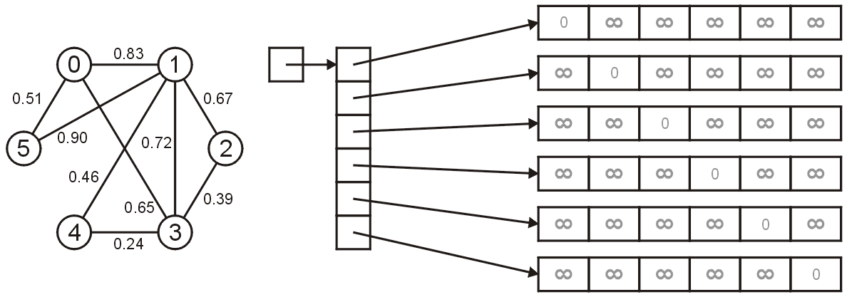
Adjacency Matrix
Let us look at the representation of our example graph
Initially none of the edges are recorded:

Slide 30
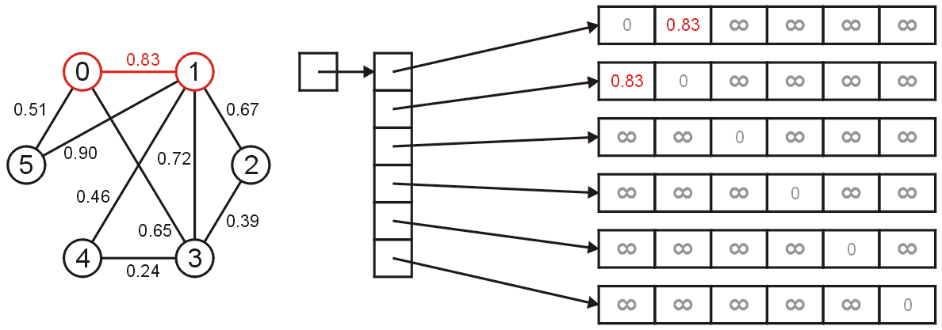
Adjacency Matrix
To insert the edge between 0 and 1 with weight 0.83, we set
matrix[0][1] = matrix[1][0] = 0.83;

Slide 31
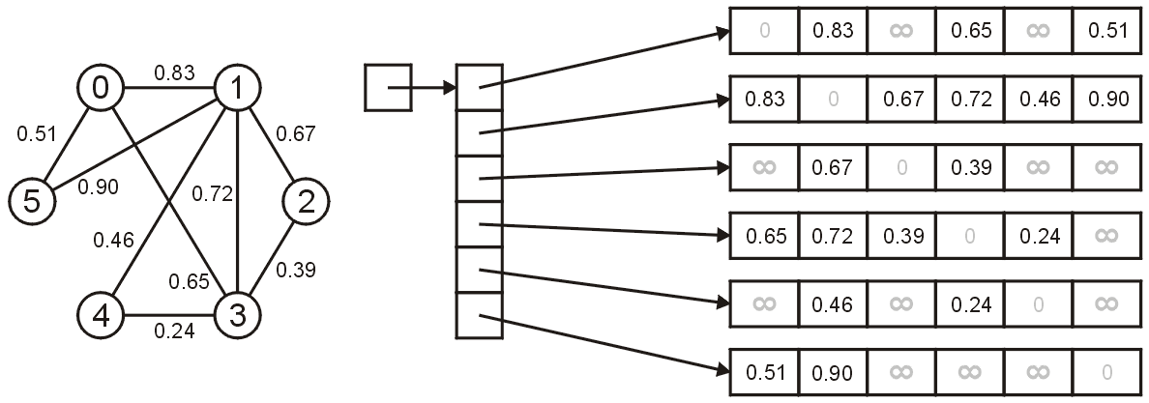
Adjacency Matrix
The final result is shown as follows
Note, however, that these six arrays could be anywhere in memory...

Slide 32
Adjacency Matrix
We have now looked at how we can store an adjacency graph in C++
Next, we will look at:
Two improvements for the array-of-arrays implementations, including:
allocating the memory for the matrix in a single contiguous block of code, and
a lower-triangular representation; and
A sparse linked-list implementation

Slide 33
Adjacency Matrix Improvement
To begin, we will look at the first improvement:
allocating all of the memory of the arrays in a single array with n² entries

Slide 34
Adjacency Matrix Improvement
For those of you who would like to reduce the number of calls to new, consider the following idea:
allocate an array of 16 pointers to doubles
allocate an array of 16² = 256 doubles
Then, assign to the 16 pointers in the first array the addresses of entries
0, 16, 32, 48, 64, ..., 240

Slide 35
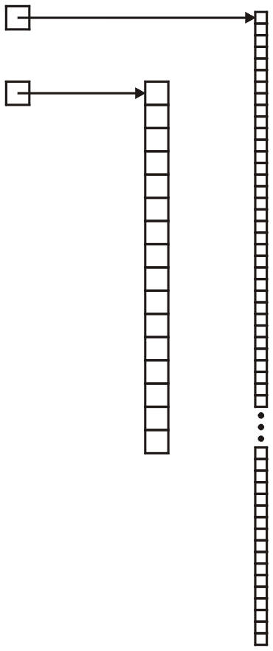
Adjacency Matrix Improvement
First, we allocate memory:
matrix = new double * [16];
double * tmp = new double[256];

Slide 36
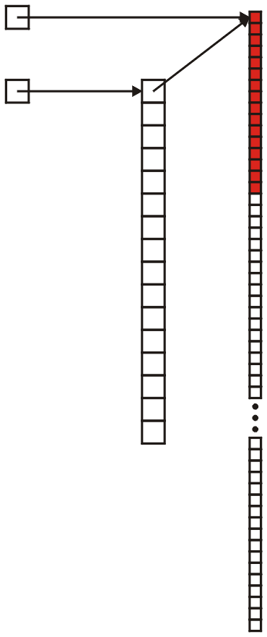
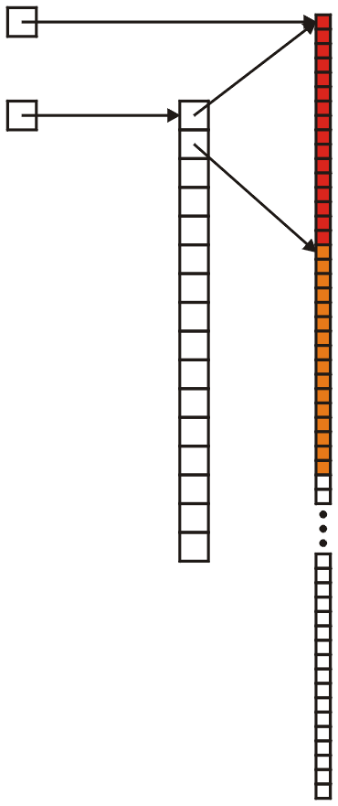
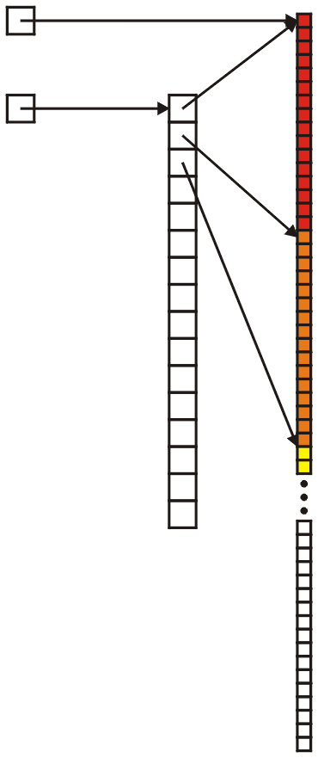
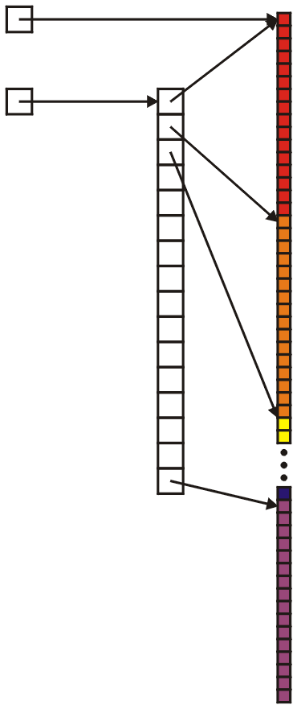
Adjacency Matrix Improvement
Next, we allocate the addresses:
matrix = new double * [16];
double * tmp = new double[256];
for ( int i = 0; i < 16; ++i ) {
matrix[i] = &( tmp[16*i] );
}
This assigns:
matrix[ 0] = &( tmp[ 0] );
matrix[ 1] = &( tmp[ 16] );
matrix[ 2] = &( tmp[ 32] );
.
.
.
matrix[15] = &( tmp[240] );

Slide 37
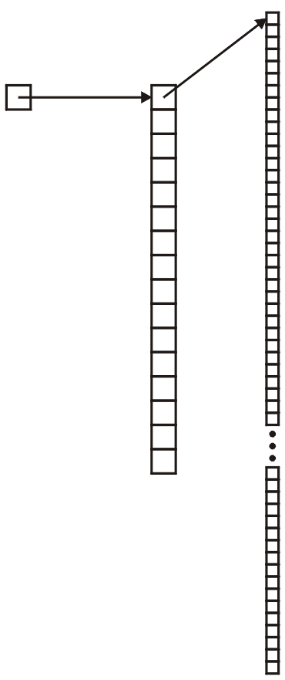
Adjacency Matrix Improvement
Deleting this array is easier:
delete [] matrix[0];
delete [] matrix;

Slide 38
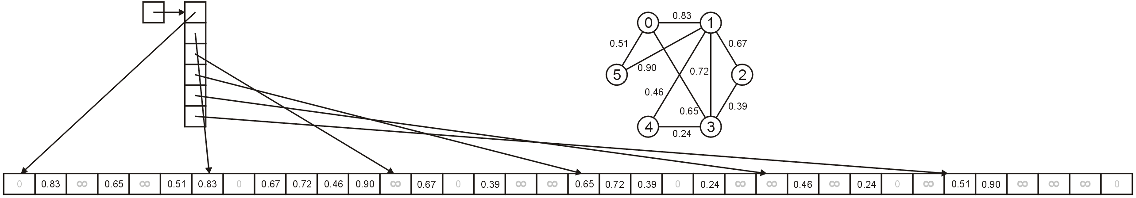
Adjacency Matrix Improvement
Our sample graph would be represented as follows:

Slide 39
Lower-triangular adjacency matrix
Next we will look at another improvement which can be used for undirected graphs
We will store only half of the entries
To do this, we must also learn about pointer arithmetic

Slide 40
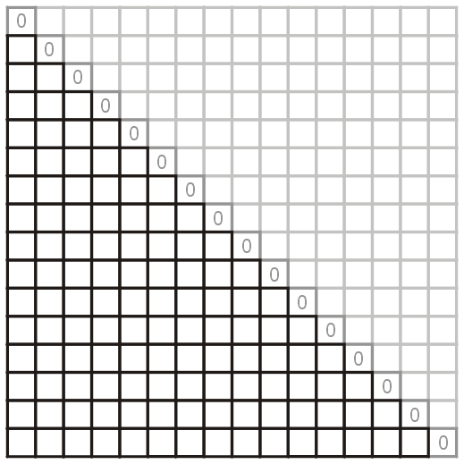
Lower-triangular adjacency matrix
Note also that we are not storing a directed graph: therefore, we really need only store half of the matrix
Thus, instead of 256 entries, we really only require 120 entries

Slide 41
Lower-triangular adjacency matrix
The memory allocation for this would be straight-forward, too:
matrix = new double * [16];
matrix[0] = 0;
matrix[1] = new double[120];
for( int i = 2; i < 16; ++i ) {
matrix[i] = matrix[i – 1] + i - 1;
}

Slide 42
Lower-triangular adjacency matrix
What we are using here is pointer arithmetic:
in C/C++, you can add values to a pointer
the question is, what does it mean to set:
ptr = ptr + 1;
or
ptr = ptr + 2;

Slide 43
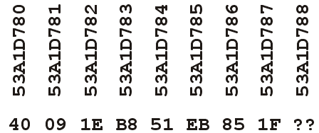
Lower-triangular adjacency matrix
Suppose we have a pointer-to-a-double:
double * ptr = new double( 3.14 );
where:
the pointer has a value of 0x53A1D780, and
the representation of 3.14 is 0x40091Eb851EB851F

Slide 44
Lower-triangular adjacency matrix
If we just added one to the address, then this would give us the value 0x53A1D781, but this contains no useful information...

Slide 45
Lower-triangular adjacency matrix
The only logical interpretation of ptr + 1 is to go to the next location a different double could exist, i.e., 0x53A1D788

Slide 46
Lower-triangular adjacency matrix
Therefore, if we define:
double * array = new double[4];
then the following are all equivalent:
array[0] *array
array[1] *(array + 1)
array[2] *(array + 2)
array[3] *(array + 3)

Slide 47
Lower-triangular adjacency matrix
Thus, the following code simply adds appropriate amounts to the pointer:
matrix = new double *[N];
matrix[0] = nullptr;
matrix[1] = new double[N*(N – 1)/2];
for( int i = 2; i < N; ++i ) {
matrix[i] = matrix[i – 1] + i - 1;
}

Slide 48
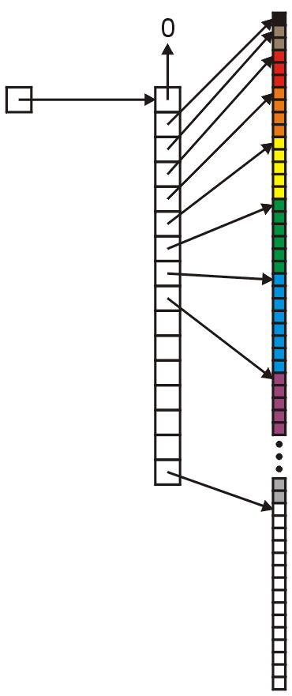
Lower-triangular adjacency matrix
Visually, we have, for N = 16, the following:
matrix[0] = nullptr;
matrix[1] = &( tmp[0] );
matrix[2] = &( tmp[1] );
matrix[3] = &( tmp[3] );
matrix[4] = &( tmp[6] );
matrix[5] = &( tmp[10] );
matrix[6] = &( tmp[15] );
matrix[7] = &( tmp[21] );
matrix[7] = &( tmp[28] );
.
.
.
matrix[15] = &( tmp[105] );

Slide 49
Lower-triangular adjacency matrix
The only thing that we would have to do is ensure that we always put the larger number first:
void insert( int i, int j, double w ) {
if ( j < i ) {
matrix[i][j] = w;
} else {
matrix[j][i] = w;
}
}

Slide 50
Lower-triangular adjacency matrix
A slightly less efficient way of writing this would be:
void insert( int i, int j, double w ) {
matrix[max(i,j)][min(i,j)] = w;
}
The benefits (from the point-of-view of clarity) are much more significant...

Slide 51
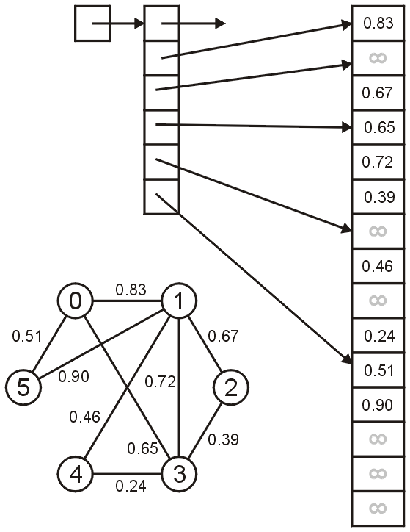
Lower-triangular adjacency matrix
Our example graph is stored using this representation as shown here
Notice that we do not store any 0’s, nor do we store any duplicate entries
The second array has only 15 entries, versus 36

Slide 52
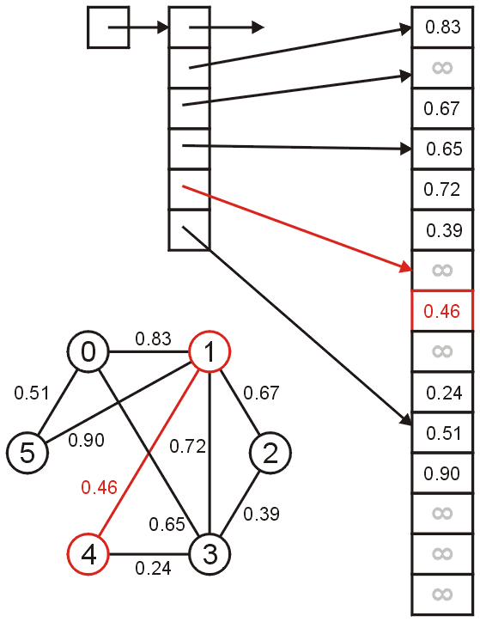
Lower-triangular adjacency matrix
To determine the weight of the edge connecting vertices 1 and 4, we must look up the entry matrix[4][1]

Slide 53
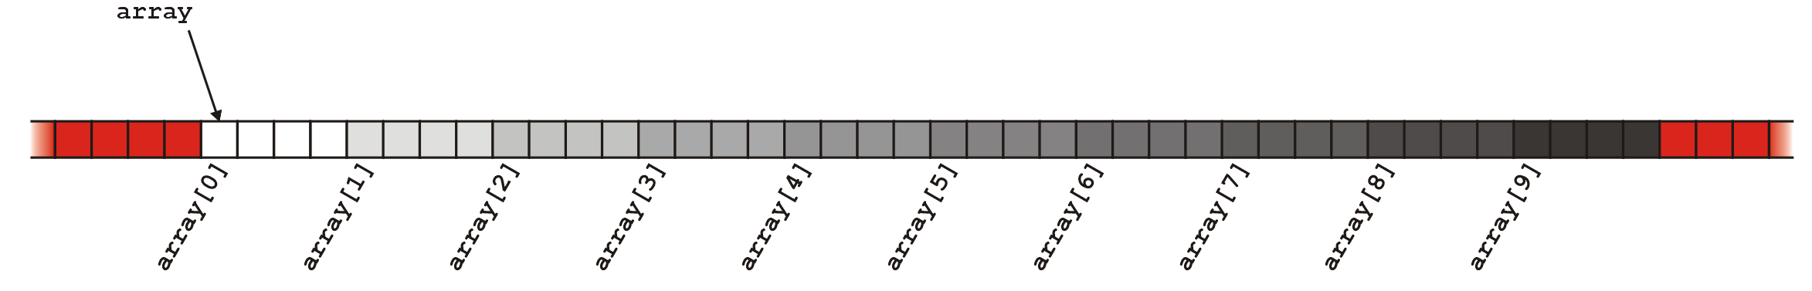
Beyond Array Bounds
Until now, some of you may have gone beyond array bounds accidentally
Recall that
int * array = new int[10];
allocates 40 bytes (4 bytes/int) and the entries are accessed with array[0] through array[9]

Slide 54
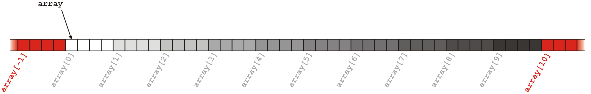
Beyond Array Bounds
If you try to access either array[10] or array[-1], you are accessing memory which has not been allocated for this array

Slide 55
Beyond Array Bounds
This memory may be used:
for different local variables, or
by some other process
In the first case, you will have a bug which is very difficult to track down
e.g., a variable will appear to change its value without an explicit assignment
In the second case, the OS will terminate your process (segmentation fault)

Slide 56
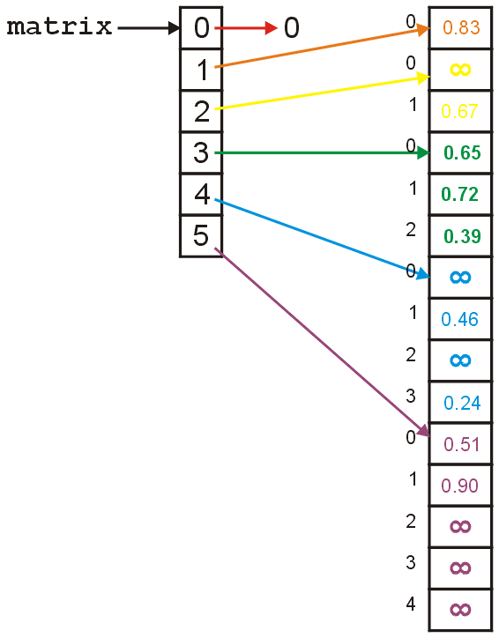
Beyond Array Bounds
Now we have a very explicit example of what happens if you go outside your expected array bounds
Notice that the value stored at matrix[4][1] is 0.46
We can also access it using either:
matrix[3][4]
matrix[5][-3]

Slide 57
Beyond Array Bounds
Thus, if you wanted to find the distance between vertices 3 and 4, if you access matrix[4][3], you get is 0.24
If, however, you access matrix[3][4], you get 0.46

Slide 58
Beyond Array Bounds
Similarly, if you wanted to find the distance between vertices 2 and 3, if you access matrix[3][2], you get is 0.39
If, however, you access matrix[2][3], you get 0.72

Slide 59
Sparse Matrices
Finally we will consider the problem with sparse matrices and we will look at one implementation using linked lists

Slide 60
Sparse Matrices
The memory required for creating an n × n matrix using an array-of-arrays is:
4 bytes + 4n bytes + 8n² bytes = Θ(n²) bytes
This could potentially waste a significant amount of memory:
consider all intersections in Canada as vertices and streets as edges
how could we estimate the number of intersections in Canada?

Slide 61
Sparse Matrices
The population of Canada is ~33 million
Suppose we have one intersection per 10 houses and four occupants per house
Therefore, there are roughly
33 million / 10 / 4 ≈ 800 000
intersections in Canada which would require 4.66 TiB of memory

Slide 62
Sparse Matrices
Assume that each intersection connects, on average, four other intersections
Therefore, less than 0.0005% of the entries of the matrix are used to store connections
the rest are storing the value infinity

Slide 63
Sparse Matrices
Matrices where less than 5% of the entries are not the default value (either infinity or 0, or perhaps some other default value) are said to be sparse
Matrices where most entries (25% or more) are not the default value are said to be dense
Clearly, these are not hard limits

Slide 64
Sparse Matrices
We will look at a very efficient sparse-matrix implementation with the last topic
Here, we will consider a simpler implementation:
use an array of linked lists to store edges
Note, however, that each node in a linked list must store two items of information:
the connecting vertex and the weight

Slide 65
Sparse Matrices
One possible solution:
modify the SingleNode data structure to store both an integer and a double:
class SingleNode {
private:
int adacent_vertex;
double edge_weight;
SingleNode * next_node;
public:
SingleNode( int, double SingleNode = 0 );
double weight() const;
int vertex() const;
SingleNode * next() const;
};
exceptionally stupid and inefficient

Slide 66
Sparse Matrices
A better solution is to create a new class which stores a vertex-edge pair
class Pair {
private:
double edge_weight;
int adacent_vertex;
public:
Pair( int, double );
double weight() const;
int vertex() const;
};
Now create an array of linked-lists storing these pairs

Slide 67
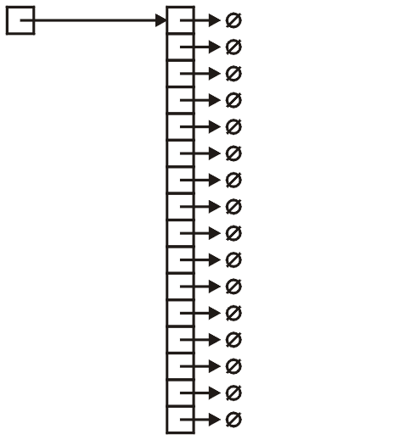
Sparse Matrices
Thus, we define and create the array:
SingleList<Pair> * array;
array = new SingleList<Pair>[16];

Slide 68
Sparse Matrices
As before, to reduce redundancy, we would only insert the entry into the entry corresponding with the larger vertex
void insert( int i, int j, double w ) {
if ( i < j ) {
array[j].push_front( Pair(i, w) );
} else {
array[i].push_front( Pair(j, w) );
}
}

Slide 69
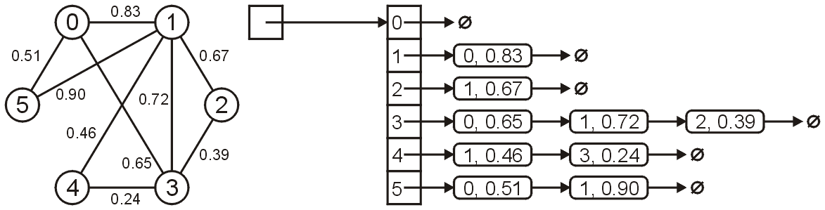
Sparse Matrices
For example, the graph shown below would be stored as

Slide 70
Sparse Matrices
Later, we will see an even more efficient implementation
The old an new Yale sparse matrix formats

Slide 71
Summary
In this laboratory, we have looked at a number of graph representations
C++ lacks a matrix data structure
must use array of arrays
The possible factors affecting your choice of data structure are:
weighted or unweighted graphs
directed or undirected graphs
dense or sparse graphs

Slide 72
References
Wikipedia, http://en.wikipedia.org/wiki/Adjacency_matrix
http://en.wikipedia.org/wiki/Adjacency_list
These slides are provided for the ECE 250 Algorithms and Data Structures course. The material in it reflects Douglas W. Harder’s best judgment in light of the information available to him at the time of preparation. Any reliance on these course slides by any party for any other purpose are the responsibility of such parties. Douglas W. Harder accepts no responsibility for damages, if any, suffered by any party as a result of decisions made or actions based on these course slides for any other purpose than that for which it was intended.

